Slide 1

EECS 330 Data Structures and Algorithms
Skip Lists
Dr. Hongyang Sun
GTA: Jigyas Sharma
Assistant Professor
Department of EECS
University of Kansas

Slide 2
Quick Recap of Linked Lists
Two types of Linked Lists: Singly-linked and Doubly-linked
Each node contains data and a reference to the next(and previous) node.
Operations over Linked Lists: Insertion, Deletion and Traversal
Drawbacks: No Random Access

Slide 3
Why Skip Lists over other Structures?
More Dynamic than Sorted Arrays
Better Memory Efficiency than Tree-like Structures
Implementation with Concurrency and Parallelism
Simple Implementation
Approximation Queries are faster

Slide 4
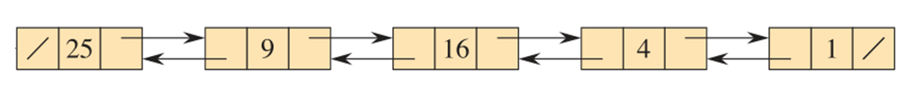
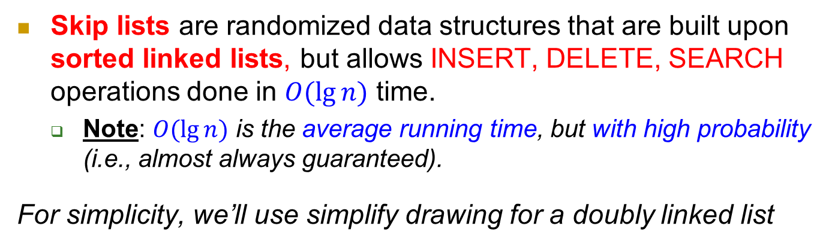
Skip lists
Skip lists are randomized data structures that are built upon sorted linked lists, but allows INSERT, DELETE, SEARCH operations done in $O(\lg{n})$ time.
  Note: $O(\lg{n})$ is the average running time, but with high probability (i.e., almost always guaranteed).
For simplicity, we’ll use simplify drawing for a doubly linked list
25
9
16
4
1

Slide 5
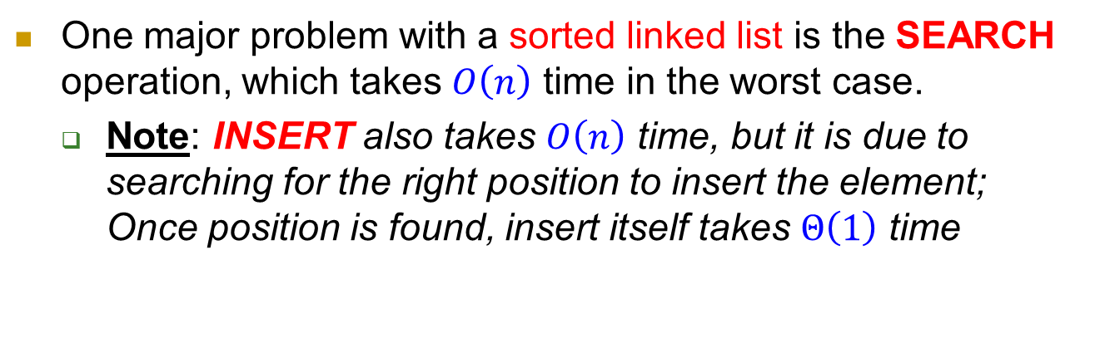
Search in linked lists
One major problem with a sorted linked list is the SEARCH operation, which takes $O\left(n\right)$ time in the worst case.
  Note: INSERT also takes $O\left(n\right)$ time, but it is due to searching for the right position to insert the element; Once position is found, insert itself takes $Θ\left(1\right)$ time
Example: SEARCH(72) in a sorted linked list
14
23
34
42
50
59
66
72
79

Slide 6
Speed up search
Skip lists speed up search by maintaining multiple sorted lists, and some elements appear in more than one list, which are connected by vertical links.
  Think of this as express trains that do not stop at every station.
Example: SEARCH(72) in two sorted lists
14
42
66
14
23
34
42
50
59
66
72
79

Slide 7

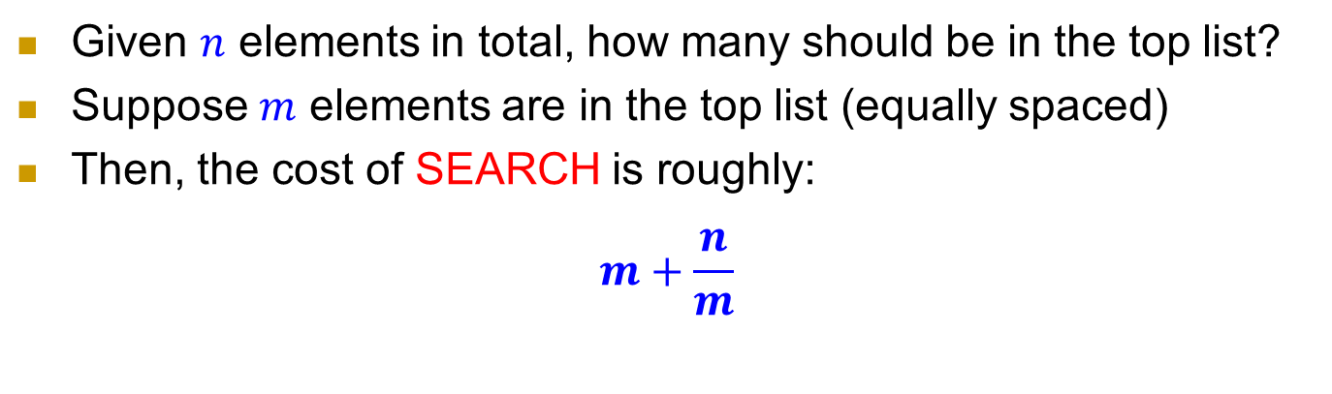



Two lists
Given $n$ elements in total, how many should be in the top list?
Suppose $m$ elements are in the top list (equally spaced)
Then, the cost of SEARCH is roughly:
$$m+\frac{n}{m}$$
searching in top list
searching in bottom list
14
42
66
$$m$$
14
23
34
42
50
59
66
72
79
$$n/m$$
$$n/m$$
$$n/m$$

Slide 8

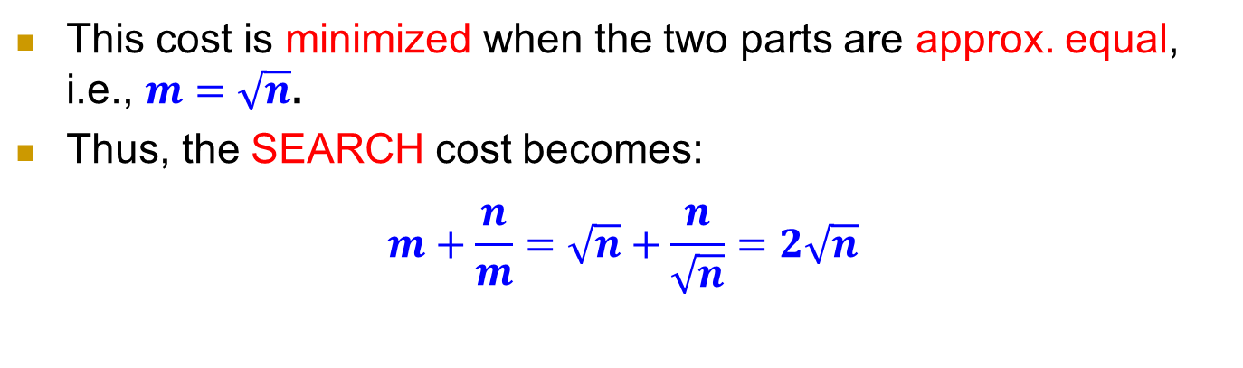



Two lists
This cost is minimized when the two parts are approx. equal, i.e., $m=\sqrt{n}$.
Thus, the SEARCH cost becomes:
$$m+\frac{n}{m}=\sqrt{n}+\frac{n}{\sqrt{n}}=2\sqrt{n}$$
14
42
66
$$\sqrt{n}$$
14
23
34
42
50
59
66
72
79
$$\sqrt{n}$$
$$\sqrt{n}$$
$$\sqrt{n}$$

Slide 9

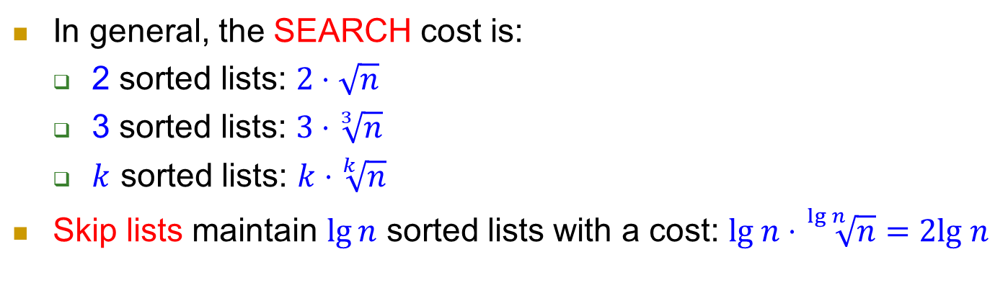
Skip lists
In general, the SEARCH cost is:
  2 sorted lists: $2⋅\sqrt{n}$
  3 sorted lists: $3⋅\sqrt[3]{n}$
  $k$ sorted lists: $k⋅\sqrt[k]{n}$
Skip lists maintain $\lg{n}$ sorted lists with a cost: $lg n⋅\sqrt[\lg{n}]{n}=2lg n$
14
79
14
50
79
$$lg n$$
14
34
50
66
79
14
23
34
42
50
59
66
72
79
In each list, at most 2 elements are searched.

Slide 10
Skip lists
Example: SEARCH(72) in a skip list
14
79
14
50
79
14
34
50
66
79
14
23
34
42
50
59
66
72
79

Slide 11
Dealing with insert and delete
INSERT and DELETE may disturb this ideal structure over time.
Skip lists handle them by maintaining roughly this structure.
14
79
14
50
79
14
34
50
66
79
14
23
34
42
50
59
66
72
79

Slide 12

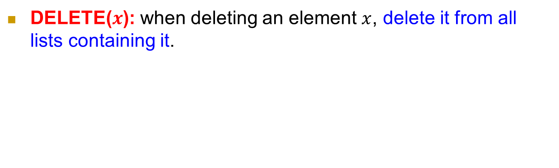
Delete in skip lists
DELETE($x$): when deleting an element $x$, delete it from all lists containing it.
14
79
14
50
79
14
34
50
66
79
14
23
34
42
50
59
66
72
79
DELETE($x$) with $x.key=66$

Slide 13
Delete in skip lists
DELETE($x$): when deleting an element $x$, delete it from all lists containing it.
14
79
14
50
79
14
34
50
79
14
23
34
42
50
59
72
79
DELETE($x$) with $x.key=66$

Slide 14

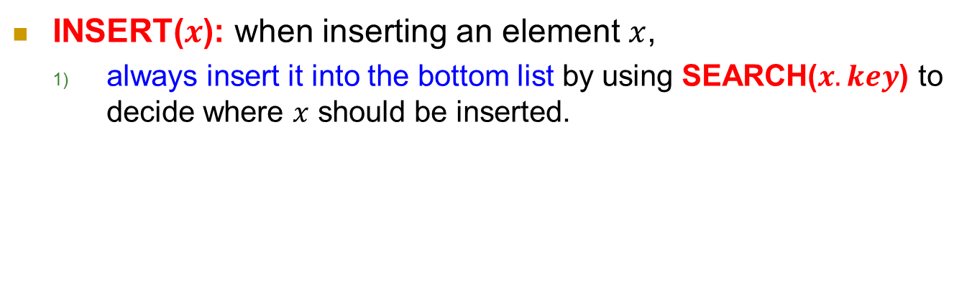
Insert in skip lists
INSERT($x$): when inserting an element $x$,
  always insert it into the bottom list by using SEARCH($x.key$) to decide where $x$ should be inserted.
14
79
14
50
79
14
34
50
79
14
23
34
42
50
59
72
79
INSERT($x$) with $x.key=75$

Slide 15
Insert in skip lists
INSERT($x$): when inserting an element $x$,
  always insert it into the bottom list by using SEARCH($x.key$) to decide where $x$ should be inserted.
14
79
14
50
79
14
34
50
79
14
23
34
42
50
59
72
75
79
INSERT($x$) with $x.key=75$

Slide 16
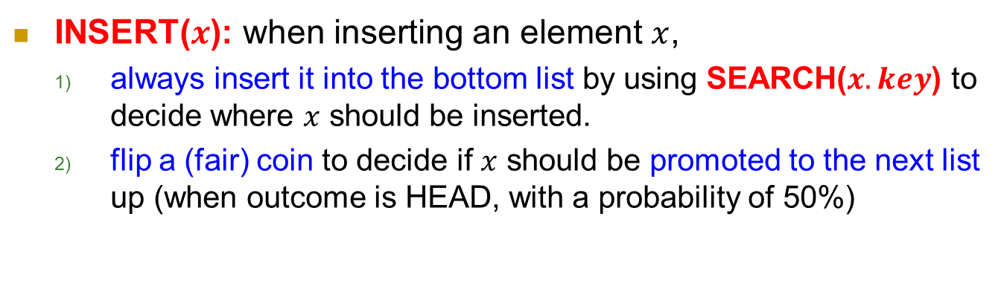
Insert in skip lists
INSERT($x$): when inserting an element $x$,
  always insert it into the bottom list by using SEARCH($x.key$) to decide where $x$ should be inserted.
  flip a (fair) coin to decide if $x$ should be promoted to the next list up (when outcome is HEAD, with a probability of 50%)
14
79
14
50
79
14
34
50
79
14
23
34
42
50
59
72
75
79
INSERT($x$) with $x.key=75$

Slide 17
Insert in skip lists
INSERT($x$): when inserting an element $x$,
  always insert it into the bottom list by using SEARCH($x.key$) to decide where $x$ should be inserted.
  flip a (fair) coin to decide if $x$ should be promoted to the next list up (when outcome is HEAD, with a probability of 50%)
14
79
14
50
79
14
34
50
75
79
coin=HEAD
14
23
34
42
50
59
72
75
79
INSERT($x$) with $x.key=75$

Slide 18
Insert in skip lists
INSERT($x$): when inserting an element $x$,
  always insert it into the bottom list by using SEARCH($x.key$) to decide where $x$ should be inserted.
  flip a (fair) coin to decide if $x$ should be promoted to the next list up (when outcome is HEAD, with a probability of 50%)
14
79
14
50
75
79
coin=HEAD
14
34
50
75
79
coin=HEAD
14
23
34
42
50
59
72
75
79
INSERT($x$) with $x.key=75$

Slide 19
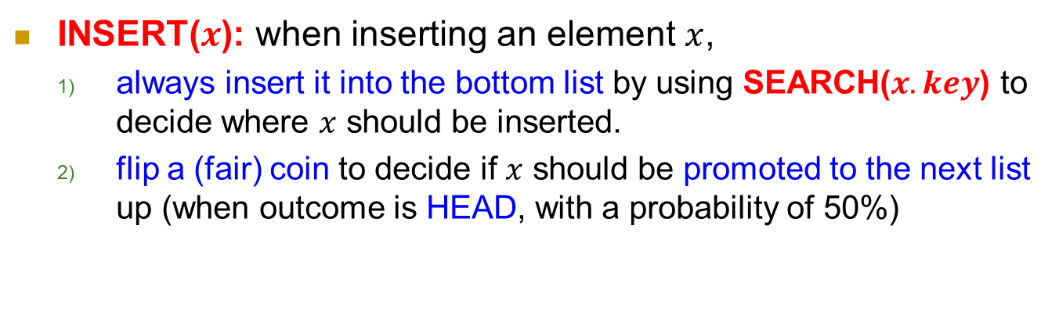
Insert in skip lists
INSERT($x$): when inserting an element $x$,
  always insert it into the bottom list by using SEARCH($x.key$) to decide where $x$ should be inserted.
  flip a (fair) coin to decide if $x$ should be promoted to the next list up (when outcome is HEAD, with a probability of 50%)
14
79
coin=TAIL
14
50
75
79
coin=HEAD
14
34
50
75
79
coin=HEAD
14
23
34
42
50
59
72
75
79
INSERT($x$) with $x.key=75$

Slide 20
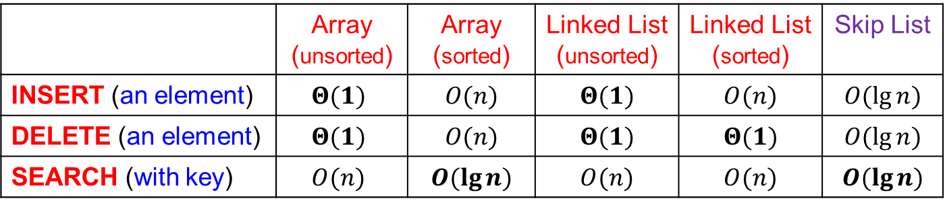
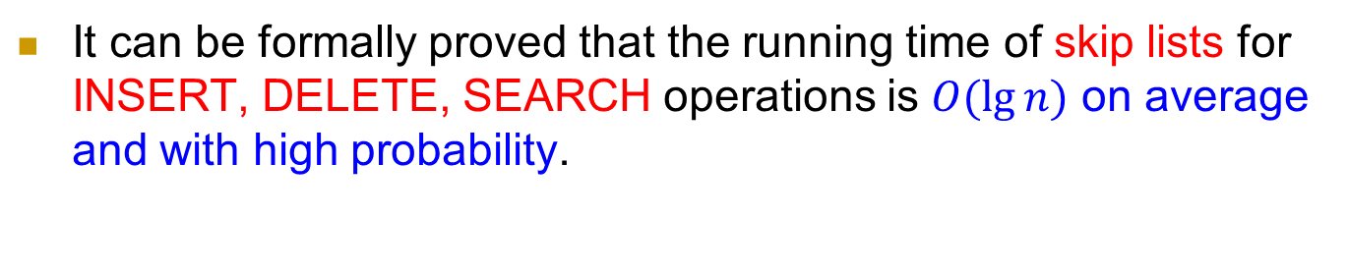
Running time of skip lists
It can be formally proved that the running time of skip lists for INSERT, DELETE, SEARCH operations is $O(\lg{n})$ on average and with high probability.
 | Array (unsorted) | Array (sorted) | Linked List (unsorted) | Linked List (sorted) | Skip List
INSERT (an element) | $$Θ(1)$$ | $$O(n)$$ | $$Θ(1)$$ | $$O(n)$$ | $$O(\lg{n})$$
DELETE (an element) | $$Θ(1)$$ | $$O(n)$$ | $$Θ(1)$$ | $$Θ(1)$$ | $$O(\lg{n})$$
SEARCH (with key) | $$O(n)$$ | $$O(\lg{n})$$ | $$O(n)$$ | $$O(n)$$ | $$O(\lg{n})$$

Slide 21
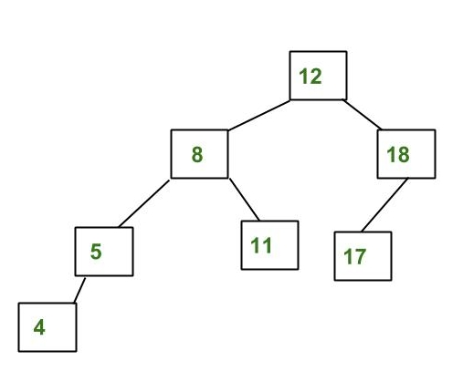
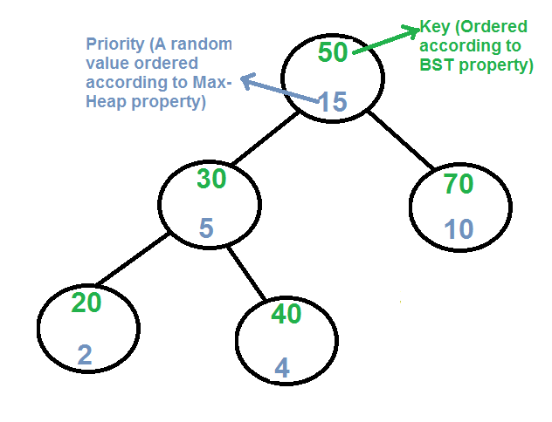
Skip Lists Alternatives
Sorted Arrays
Binary Search Trees(O(logn))
AVL Trees(O(logn))
Treaps

